Slide 1
Git and GitHub

Slide 2
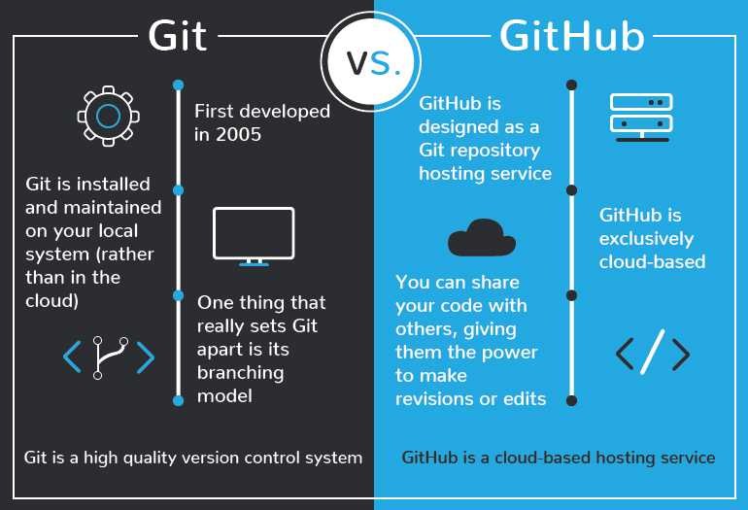

Slide 3
In simpler terms..
Git is a version control system that lets you manage and keep track of your source code history LOCALLY
GitHub is a cloud-based hosting service that lets you manage Git repositories

Slide 4
Create github acc
Install git if you haven’t
Create a new repository
Clone repo and move notes to repo
Push in git
View in github
Make a random change and show how to revert
Branches (if got time)

Slide 5
Install Git
https://git-scm.com/download/win

Slide 6
Creating an account
https://github.com/
For pro account, can link school email address to get benefits https://education.github.com/discount_requests/new

Slide 7
Create a local git repository
Basic commands in terminal : cd (change directory) , dir (list files), mkdir (make new directory)
Initialize a git repository in the root of the folder : git init
Show what’s in the folder: dir
Show hidden files: dir /a

Slide 8
Create repository in GitHub
Create a GitHub repository on the website
For the first time: git remote add origin https://github.com/user/repo.git
Right click to paste in cmd for windows, CMD+v for MacOS

Slide 9
Git status
Check the status of your repository, Example: files not staged for commit etc

Slide 10
Staging files for commit
git status
git add file1 file2
git status

Slide 11
Commit files to local repository
git commit –m “commit message”
git status

Slide 12
Push to remote repository
git push –u origin master
FOR HELP: can use –h flag

Slide 13
README.md
README will be displayed as a preview on your repository
Each folder and subfolder can have their own README

Slide 14


To view on mobile:
Android
Download FastHub
Apple
Download CodeHub

